Slide 1
Android 01: Fundamentals
David Meredith
dave@create.aau.dk

Slide 2
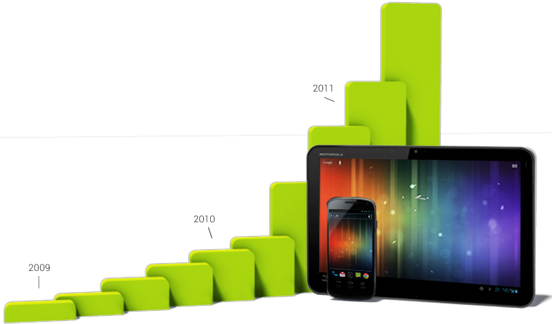
What is Android?
Most popular mobile platform
Runs on 100s of millions devices in 190 countries
a million new users per day
Based on Linux, programmed with Java
Can easily deploy same app to different devices (e.g., phones, tablets, I/O boards...)
Open marketplace for selling your app (Google Play)

Slide 3
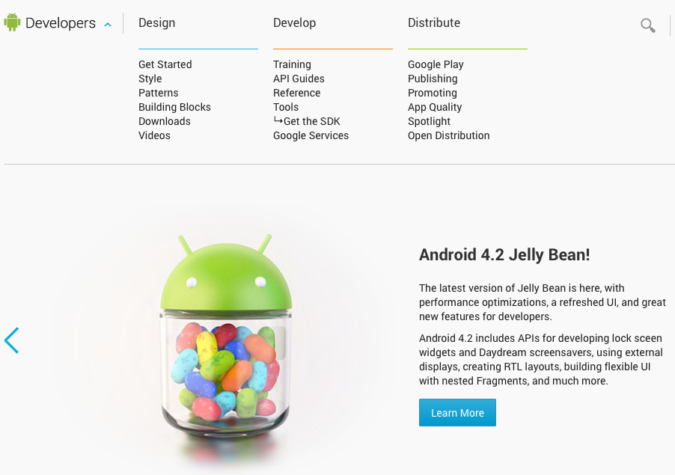
developer.android.com
Everything you need to know and all the tools you need in order to develop Android apps are available at
http://developer.android.com

Slide 4
Installing ADT Bundle
You can download the Android SDK from
http://developer.android.com/sdk/index.html
You should install the ADT Bundle for your operating system. This includes
Eclipse + ADT plugin
Android SDK Tools
Android Platform-tools
The latest Android platform (currently JellyBean, 4.2)
The latest Android system image for the emulator

Slide 5
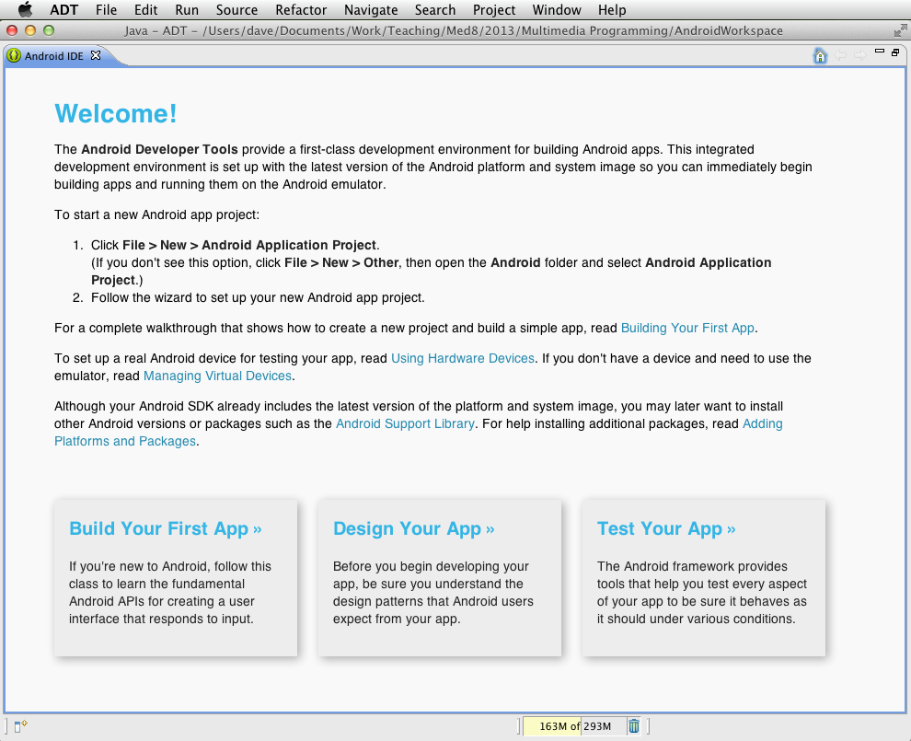
Installing SDK and starting ADT
Extract the downloaded bundle, e.g.,
adt-bundle-mac-x86_64.zip
Go to the eclipse folder in the extracted files and start the Eclipse program

Slide 6
Hello World!
Create a new Android application directly using the menu

Slide 7
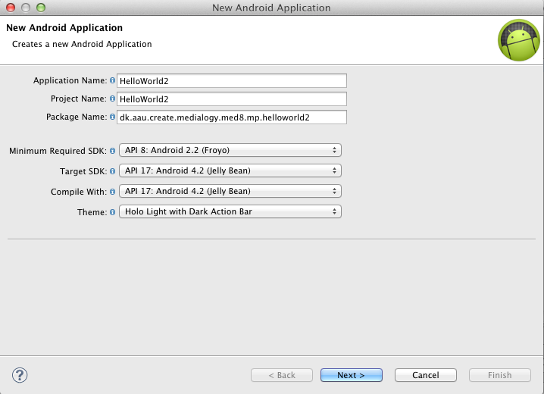
Creating a new application
Need to give app a fully-qualified package name
Minimum required SDK should ideally be as low as possible and target SDK will generally be the most recent version of the Android API

Slide 8
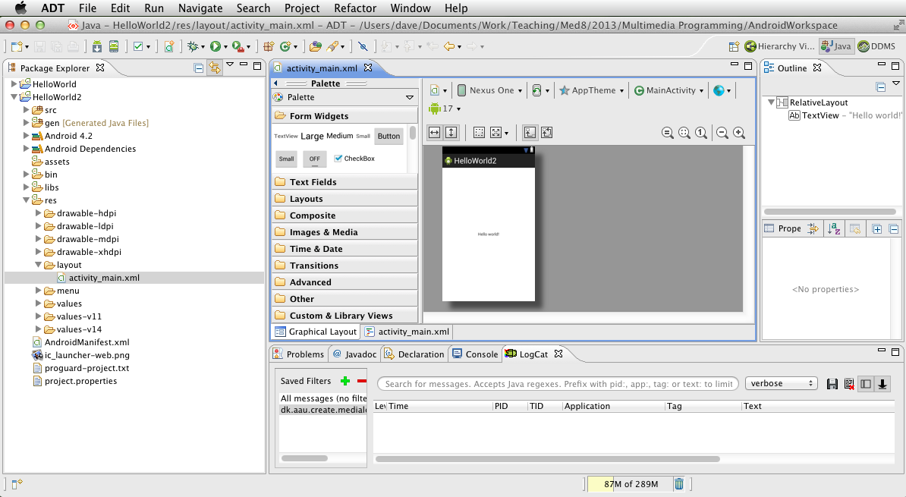
Hello World!
If you accept all the default options, you end up with a “BlankActivity” program
Will open with “activity_main.xml” file which is the definition of the layout of the main activity (i.e., the opening screen of the app)

Slide 9
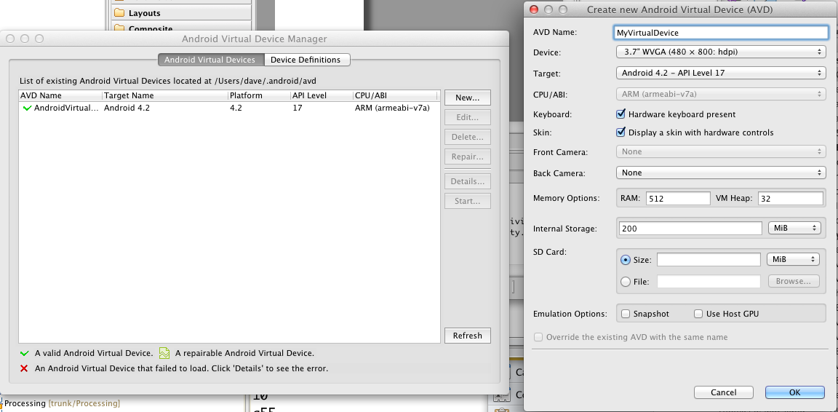
Running on a virtual device
You can run your program on a virtual device (emulator) provided with the ADT
To run on a virtual device (AVD), we need to have such a device defined and running
Open Android Virtual Device Manager
Window > Android Virtual Device Manager
Create a new device if there isn’t already one defined, click on “Start” button
WARNING – the device can take a LONG time to start (10-15 minutes...)

Slide 10
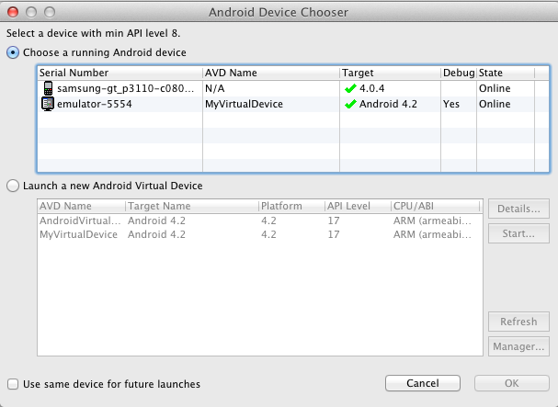
Running on a virtual device
Then just click on green Run button in Eclipse
Opens a dialog in which you choose the Android device you want to run your app on

Slide 11
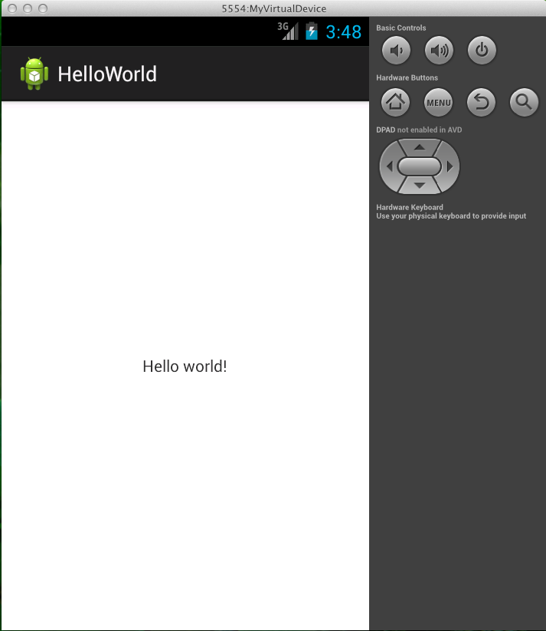
Running on a virtual device
Emulator runs program on virtual device

Slide 12
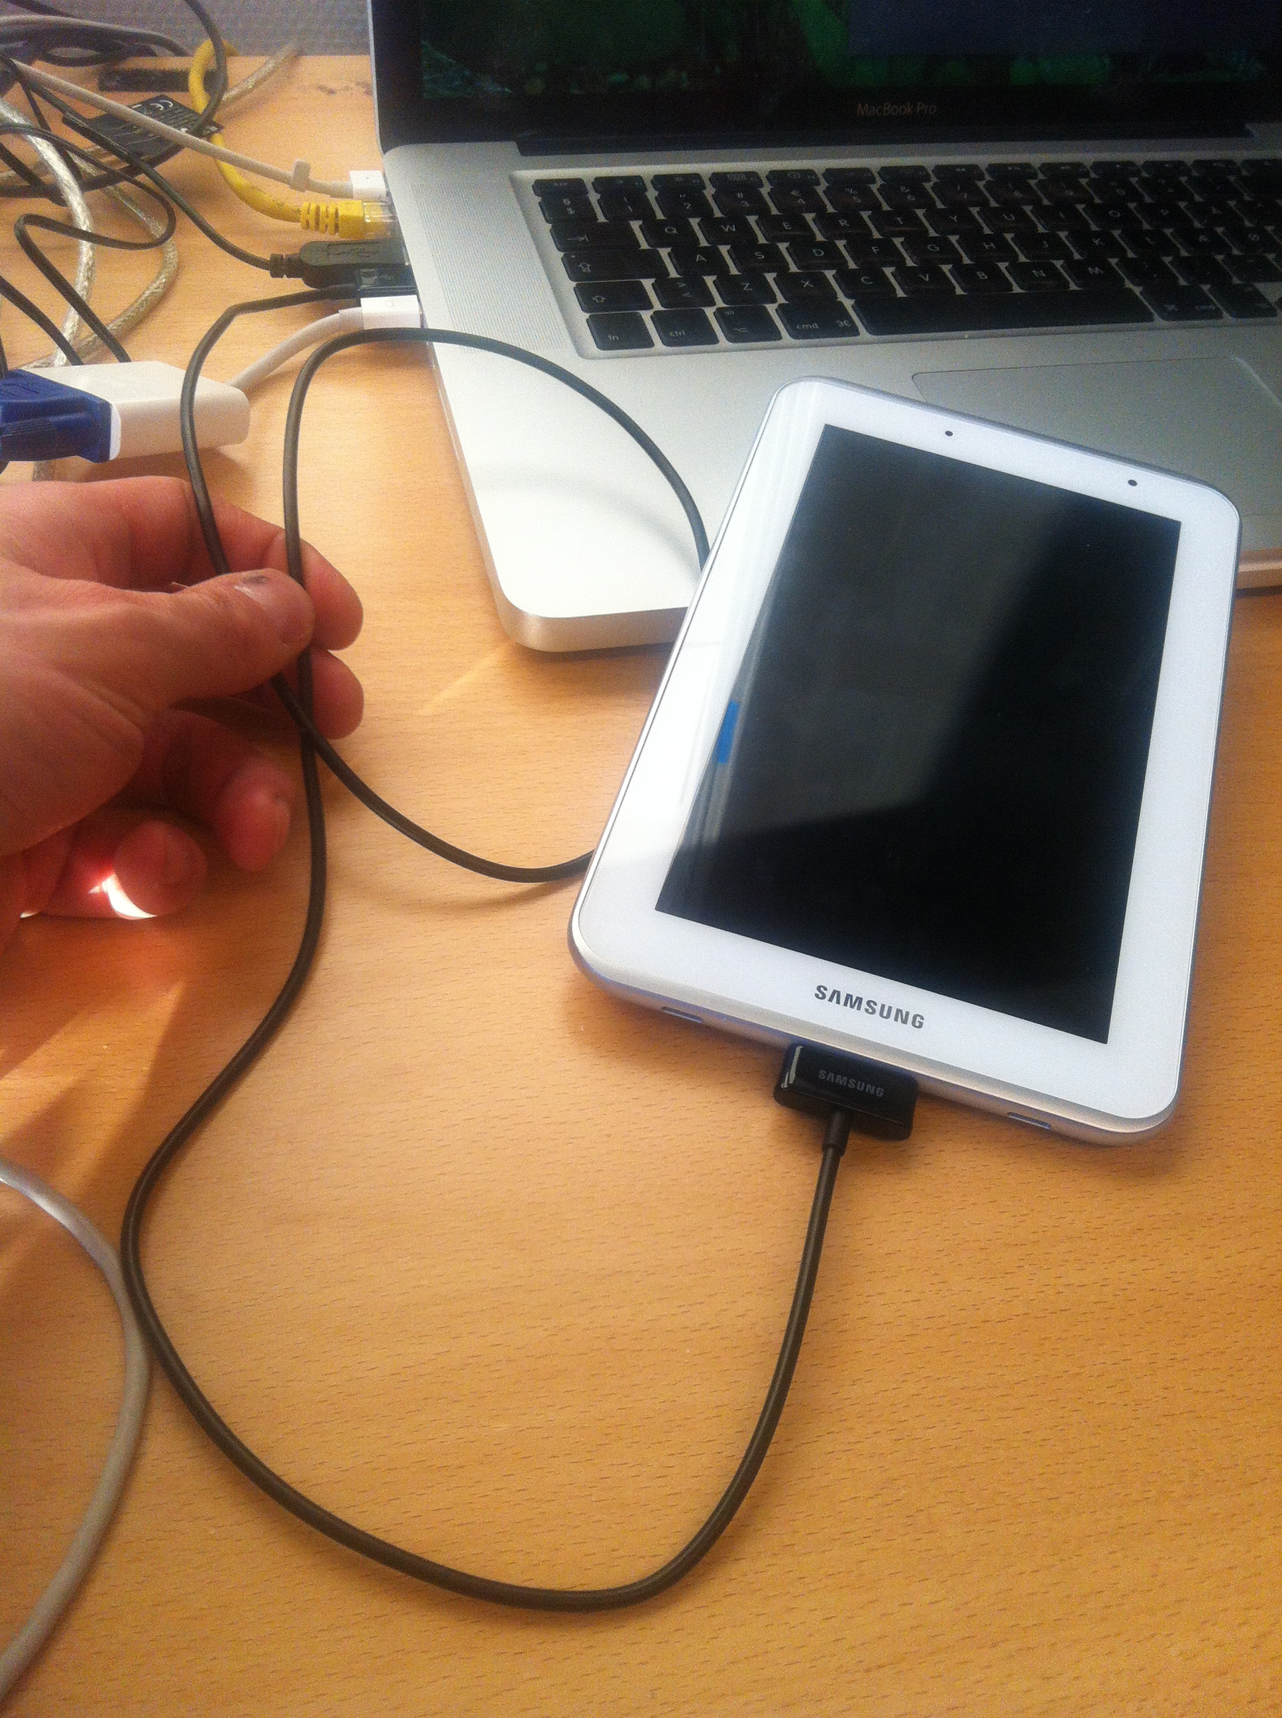
Running on a real device
Connect the device with its USB cable to the computer running the ADT
Make sure the device is on and that Android has booted up
Unlock the screen on the device

Slide 13
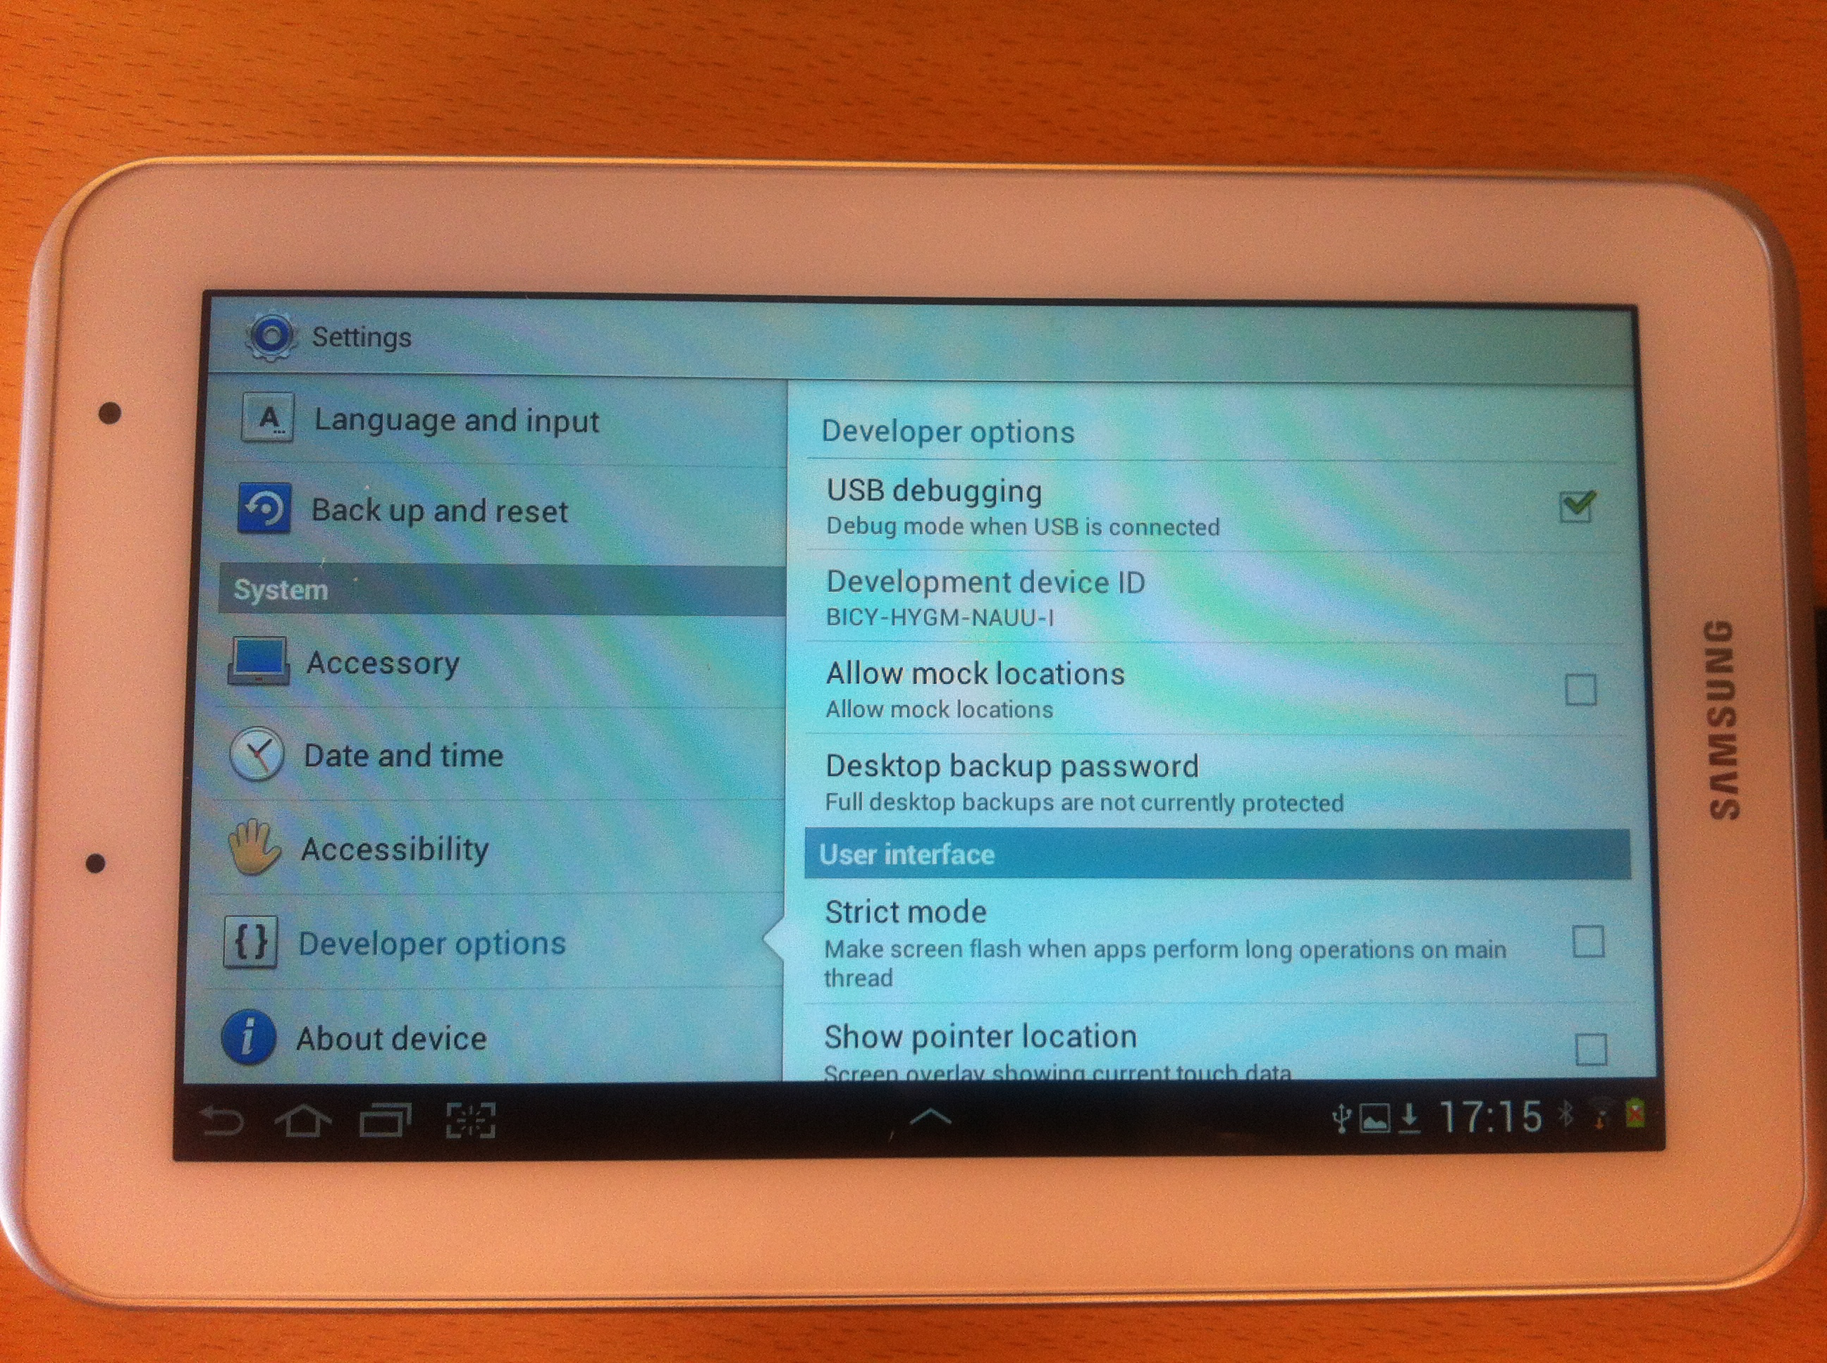
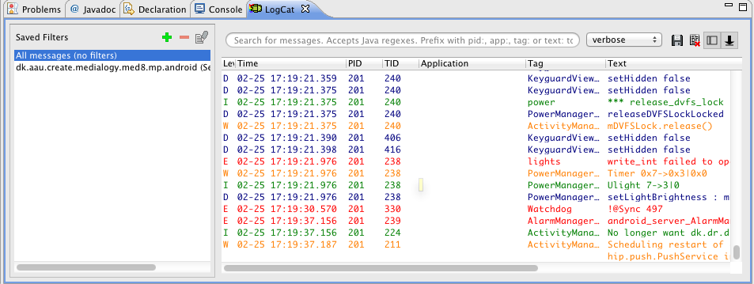
Developer options on device
Check the developer options on your real device
Make sure that “USB debugging” is checked

Slide 14
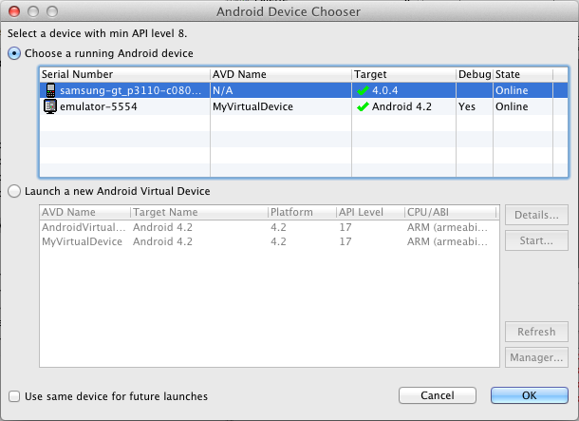
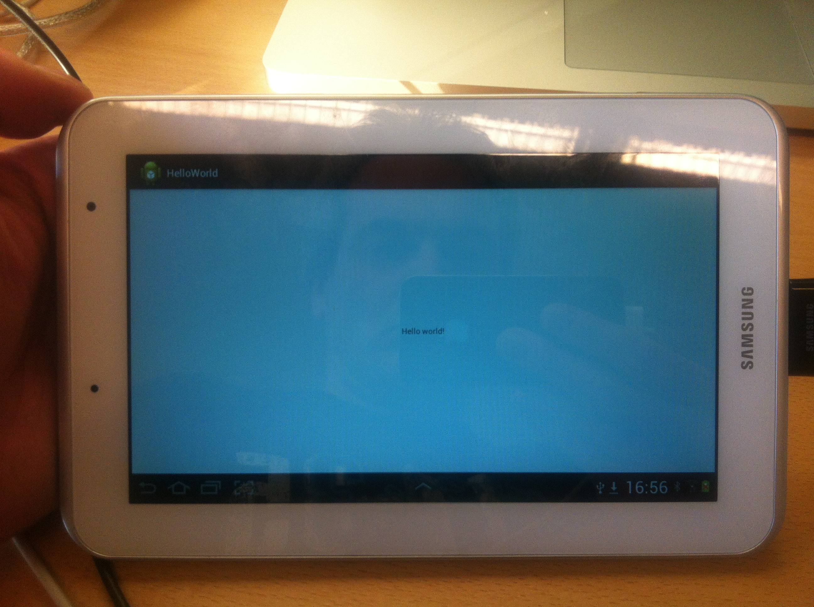
Running on a real device
Press the green button and choose the real device from the device chooser
The app will then start on the device

Slide 15
Try it! (Preferably on a real device!)

Slide 16
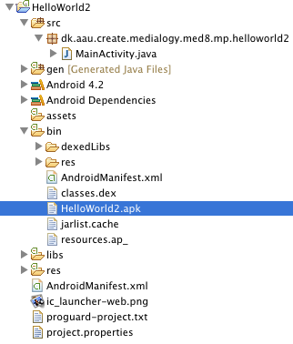
Application fundamentals
Android apps are written in Java
Android SDK compiles code for a single application into an Android package stored in a single .apk file

Slide 17
Application fundamentals
Android (Linux)
Each Android app lives in its own security “sandbox”
Android OS is a multi-user Linux system
Each app is a different user
OS assigns unique user ID to each app
Only user ID assigned to an app can access resources in that app directly
Each process has its own virtual machine (VM)
App runs in isolation from other apps
Each app runs in its own Linux process
Process for an app starts when a component of that app is first executed
Process ends when all of an app’s components have shut down
“Principle of least privilege” - app only has access to what it needs in order to run
Virtual machine
Process
App

Slide 18
Application components
Each application built up from components
Activities
Services
Content providers
Broadcast receivers
System can access app through the app’s components

Slide 19
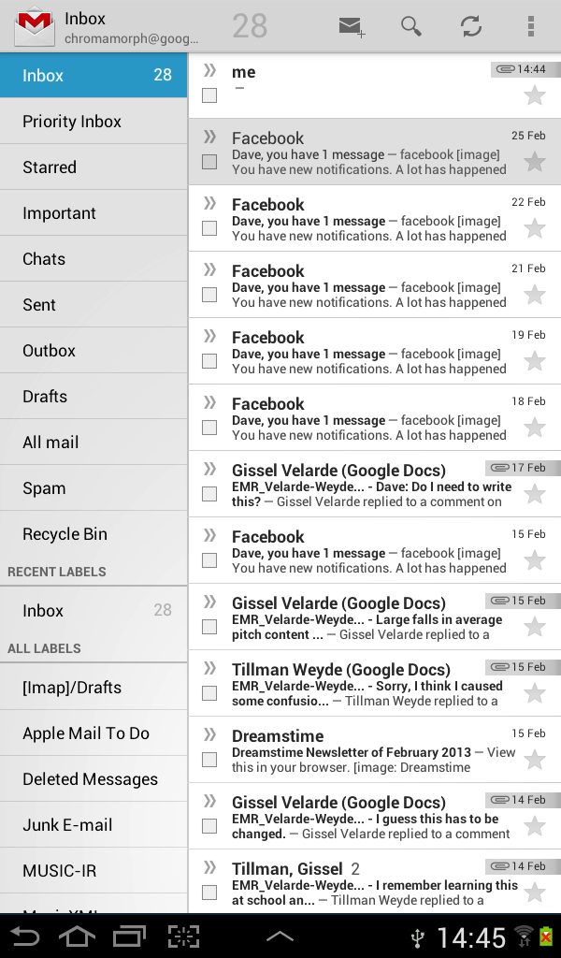
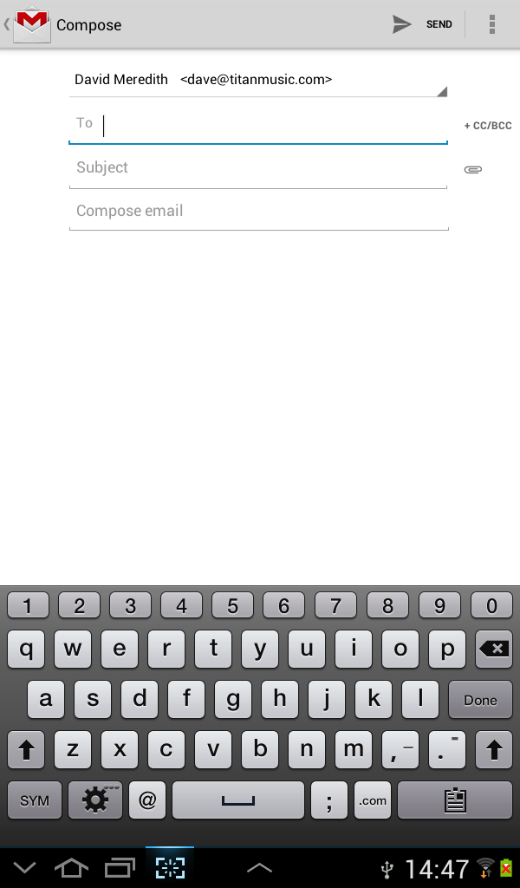
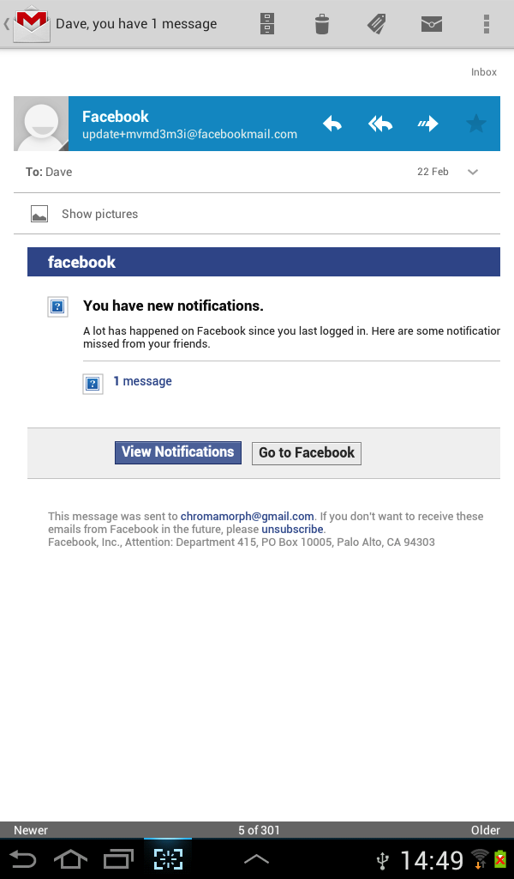
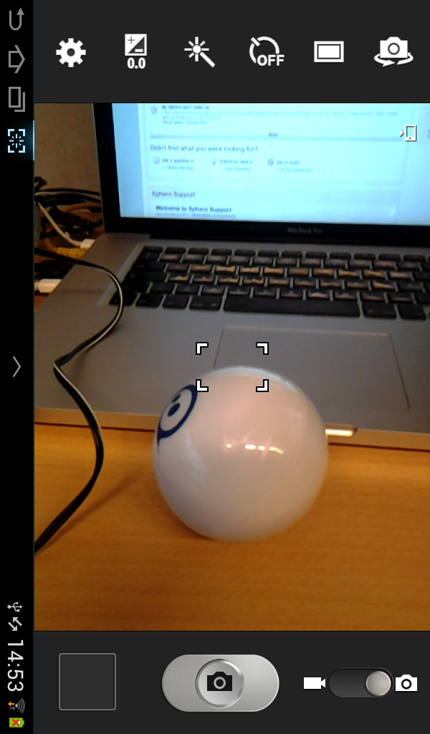
Activities
An activity represents a single screen
e.g., in an email program, an activity could be
a list of emails in the user’s inbox
a screen for composing a new email
a screen for reading an email
Any application can start any activity (so long as the app that owns the activity allows it)
e.g., a camera app can start the email composing activity to let user send a picture
Activity implemented as subclass of Activity class

Slide 20
Services
Service runs in the background
performing long-running operations
doing work for remote processes
No user interface
Examples include
playing background music while other apps are running
fetching data over the network without blocking user interaction with an activity
Other components can start or bind to services
Implemented as a subclass of Service

Slide 21
Content providers
Content provider manages a shared set of application data
files
SQLite database
web
any other persistent storage location your app can access
Content provides access to data for other components and applications
E.g., there is a content provider that manages user’s contact information
Any application can query part of this contact provider to read and write information about a person

Slide 22
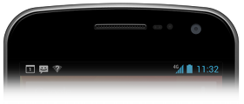
Broadcast receivers
Broadcast receiver responds to system-wide broadcast announcements e.g.,
screen has turned off
battery is low
picture has been captured
Applications can also initiate broadcasts
e.g., data downloaded and ready to use
Don’t have interfaces but may create a status bar notification

Slide 23
Starting components in other apps
System
Any Android app can start a component in another app (if the second app allows it)
E.g., camera app may start the “Send Mail” activity in a Mail app to send a picture
Called component starts in the process of its own app
Process for that app is started if it is not already running
So Android apps don’t have a single point of entry – no “main()” method
App cannot directly start another app’s component
Must be done via the operating system
Sends an intent to the operating system
Operating system tries to activate a component that can fulfill the intent
Intent

Slide 24
Activating components - Intents
System
Activities, services and broadcast receivers are activated by asynchronous messages called intents
Intent is a messenger that requests an action from another component (which could be in another application)
Implemented as an Intent object
Explicit Intent: request for a specific component
Implicit Intent: request for a particular type of component
Intent

Slide 25
Activating activities and services
System
When activating an activity or a service, the intent defines
the action to perform
e.g., “send something”, “view something”
possibly URI of some data to act on
e.g., data that the started activity needs in order to work
Can also start an activity in order to receive a result
Activity returns result in an Intent
e.g., URI to contact data for a particular person
Intent

Slide 26
Broadcast receivers and Intents
For a broadcast receiver, the intent defines the announcement being broadcast
e.g., “Battery is low”

Slide 27
Activating a Content Provider
Activated when targeted by a request from a ContentResolver object
All components who need to access or modify data managed by a Content Provider must do so through the ContentResolver
ensures that client object can only perform actions on the content source that are permitted by the ContentResolver

Slide 28
Methods for starting activities
Start Activity or give it a job:
startActivity(Intent [, Bundle])
Launch an activity without receiving any information back when the activity exits
startActivityForResult(Intent intent, int rc, Bundle options)
Start activity for which you require a result
On return of result, onActivityResult() method will be called with rc

Slide 29
Methods for starting services
Can start a service or give new instructions to an ongoing service by passing an Intent to startService()
Can bind to a service by passing an Intent to bindService()

Slide 30
Methods for initiating broadcasts
Pass an Intent to
sendBroadcast()
sendOrderedBroadcast()
sendStickyBroadcast()

Slide 31
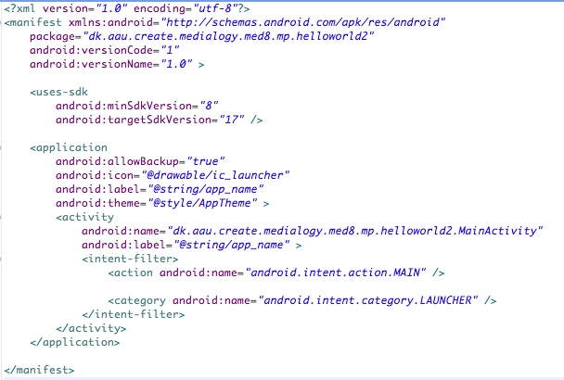
The Manifest File
Each application component must be declared in the manifest file, AndroidManifest.xml
Manifest file should be in the root of the app project directory

Slide 32
Other functions of the manifest file
Manifest file also
gives user permissions the application requires
e.g., internet access, access to contacts database
gives minimum API level required by application
declares hardware and software features required
e.g., bluetooth, camera, multitouch screen
non-Android API libraries the application needs
e.g., Google maps library

Slide 33
Declaring components in the manifest file
Main task of manifest file is to declare components in app
Each component has an element inside the <application> element
Can be <activity>, <service>, <receiver> or <provider>
android:icon identifies image files for icons at various resolutions
android:name is the fully qualified name of the activity class
android:label is the user-visible name of the activity

Slide 34
Declaring component capabilities
Intents can be explicit or implicit:
Explicit intent: sent to a specific component’s class
Implicit intent: directed at a specific type of component
Implicit intents specify an intent action to be performed by a component
e.g., “Send an email”
System provides user with list of possible components to carry out the intent
Intent actions to which a given component can respond are defined in the intent filters in its declaration in its app’s manifest file
Stored in <intent-filter> element inside component element
e.g., email program might have a mail compose activity that can respond to an ACTION_SEND intent action
MainActivity in HelloWorld responds to ACTION_MAIN intent actions

Slide 35
Declaring application requirements
Should declare any special requirements in the manifest file
Screen size and density: <supports-screens>
screen size
small, normal, large, extra large
screen density
low, medium, high, extra high
Input configurations: <uses-configurations>
e.g., keyboard, trackball, etc.
Device features
e.g., camera, light sensor, bluetooth
Platform version: <uses-sdk>
e.g., Android 2.3 is API level 9, Android 4.2 is API level 17

Slide 36
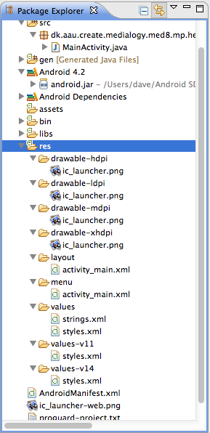
Application resources
Android app requires resources other than just Java code
e.g., images, audio files, strings, layouts, animations, menus, styles, colours...
Can provide variety of alternative resource sets to optimize for different devices
e.g., different screen densities
Can use different qualifiers in names of resource directories

Slide 37
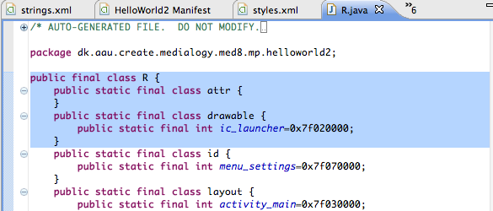
R.java
Each resource is automatically assigned a unique integer ID
Use this ID to reference the resource from your application code
e.g., image called ic_launcher.png in res/drawable-hdpi/ directory has constant defined in R.java (see above) R.drawable.ic_launcher

